Slide 1
Image Filtering
Gaussian Smoothing
Gaussian smoothing, or blurring, is a convolutional filter that is used to “blur” an image in order to remove noise.
It does a poor job in preserving image details.
It utilizes a kernel representing a Gaussian curve, which is normalized. Usually, its mean (μ) is set to 0.

Slide 2
Image Filtering
Gaussian Smoothing
For this exercise you are tasked to perform Gaussian smoothing on an image that has been corrupted by noise.
The algorithm takes as input a noise image, the size of the gaussian kernel and the sigma of the gaussian distribution and creates the gaussian kernel, which is then normalized. Afterwards, it calculates the 2D convolution of the noise image and the gaussian kernel. It uses 0-padding in order to prevent the creation of black borders in the image.
Finally, it returns the filtered image, which is displayed alongside the noise one.

Slide 3


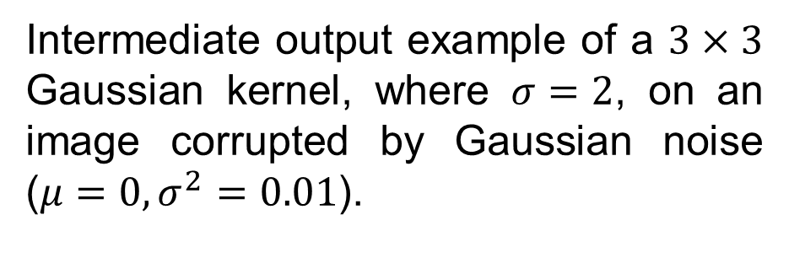
Image Filtering
Gaussian Smoothing
Input example.
Intermediate output example of a $3×3$ Gaussian kernel, where $σ=2$, on an image corrupted by Gaussian noise ($μ=0, σ^{2}=0.01$).

Slide 4
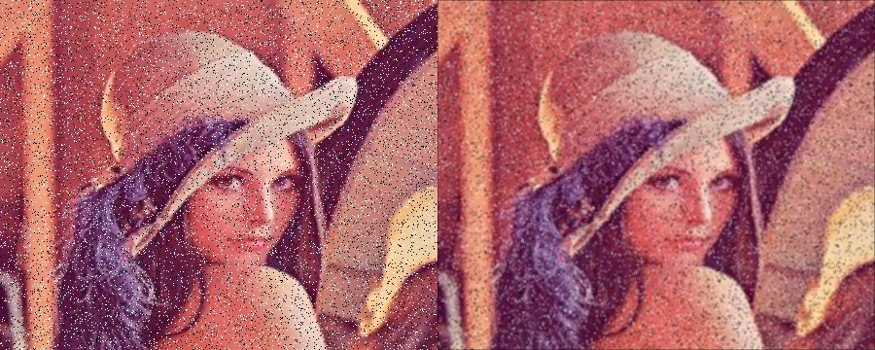
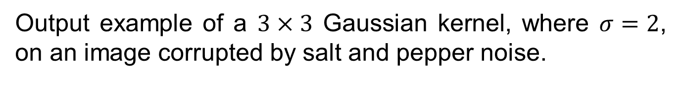
Image Filtering
Gaussian Smoothing
Output example of a $3×3$ Gaussian kernel, where $σ=2$, on an image corrupted by salt and pepper noise.

